Slide 1
Usability testing report: Small business lending data submission beta platform

Slide 2
Background

Slide 3
Summary
This was our second round of 1:1 usability testing for the small business lending data submission platform filing flow.
Participants used the beta platform to complete three tasks related to the filing process.
We identified multiple improvements to the design before our open beta launch and opportunities for further research and design work.
Additionally, we met with two vendors to test file uploads.

Slide 4
Research goals
Our second round of testing aimed to accomplish three things:
Answer 11 specific questions from our pre-clearance review and internal design reviews
Identify whether there were any bugs not found in testing prior to launch
Determine what effect some changes from the first round of testing had on overall usability

Slide 5
Methodology
4 participants for usability testing
Personally recruited and invited via email.
Participants had a diverse range of backgrounds and experiences
Large and small institutions
Experiences from 1071 reporting, regulatory issues, HMDA, and commercial loans
60 minute, 1:1 moderated sessions using User Zoom and the beta platform.

Slide 6
Findings, recommendations, and design updates

Slide 7
Study results overview
Participants were overall successful completing test tasks
3 of 4 tasks had a 100% completion rate
1 task had a 50% completion rate
We gained a clearer understanding of what causes usability issues related to the filing flow
Participants appreciated the linear flow of the filing process
We answered all 11 of our research questions
Notes:
1 & 2: The last task failed in a way that was a bit surprising, but proved insightful for understanding the root cause of most of the usability issues we found
3: The general design strategy is solid, even if we need to modify it’s implementation
4: We’re not going through all of the results, but we will make them available.

Slide 8
Recommendations overview
With open beta coming soon, we generated 4 types of recommendations:
No change needed
Implement a solution
Implement an improvement but plan for a more comprehensive solution
Investigate a problem further

Slide 9
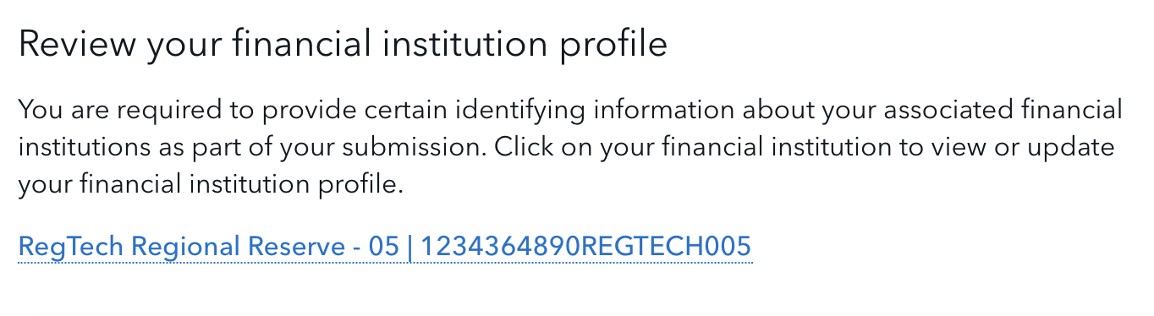
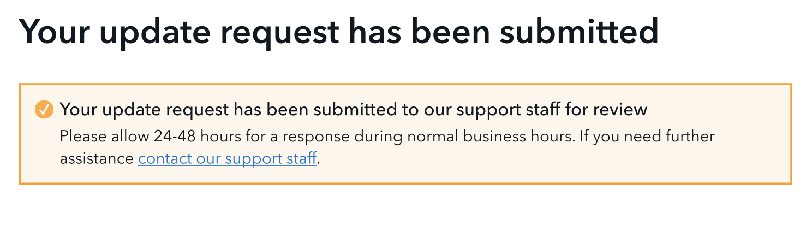
No change needed
Finding your institution’s profile
Whether filers have any difficulty finding their financial institution’s profile.
Finding: No difficulty accessing their institution’s profile.
Response times language
Whether filers have the appropriate expectation for when they’ll receive a response to their support request.
Finding: The current language set the appropriate expectation

Slide 10
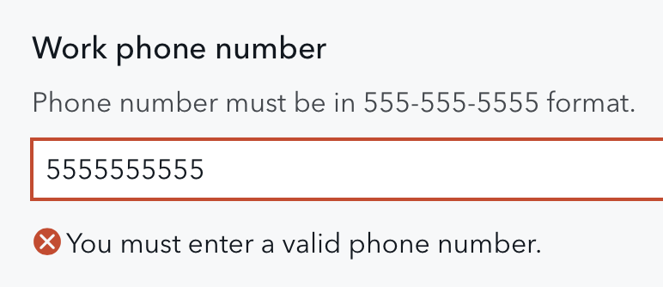
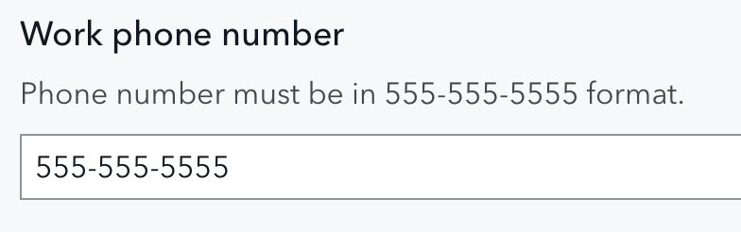
Implement a solution
Point of contact phone number format
Participants had the POC form autofill from their browser or manually entered the information.
No one entered their phone number with hyphens, which triggered an error when they tried to go to the next step
Recommendation: Auto-format phone numbers so that they have the required format.
Notes:
Additional example: confirmation emails. Confirmation emails are a known solution, but there’s some collaboration needed to implement it. (Use previous slide to illustrate)
Autofill and whether that populates the right info for the POC is a different question.

Slide 11
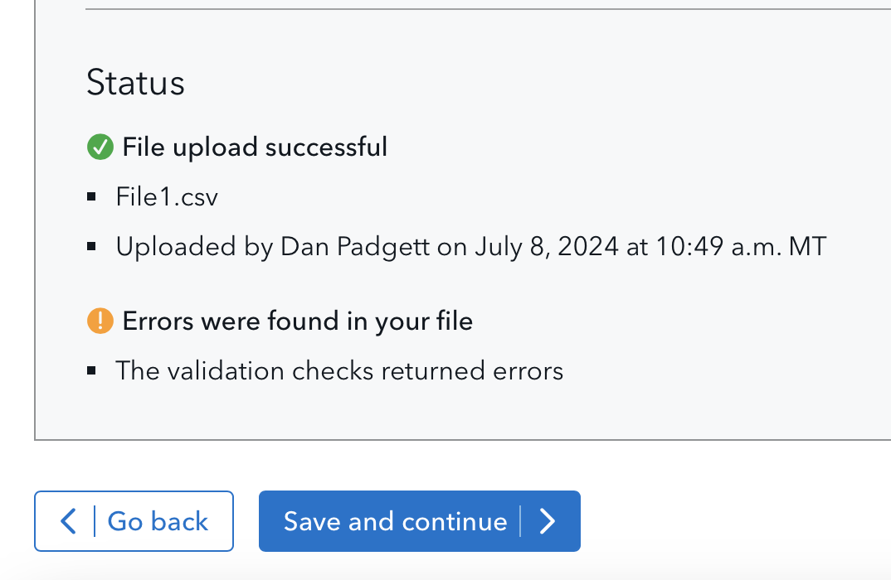
Implement an improvement
“Save and continue” button language
Participants were unsure how to view the errors in their file.
The meaning they assigned to “Save and continue” made them hesitant to click the button.
This was symptomatic of a deeper problem.
But an immediate improvement is to change the language so they better understand how to view errors.
Notes:
For point 2: ”Save” communicated that they wanted to submit a file with errors. The button language did not communicate that they would go to a page that displayed error details.

Slide 12
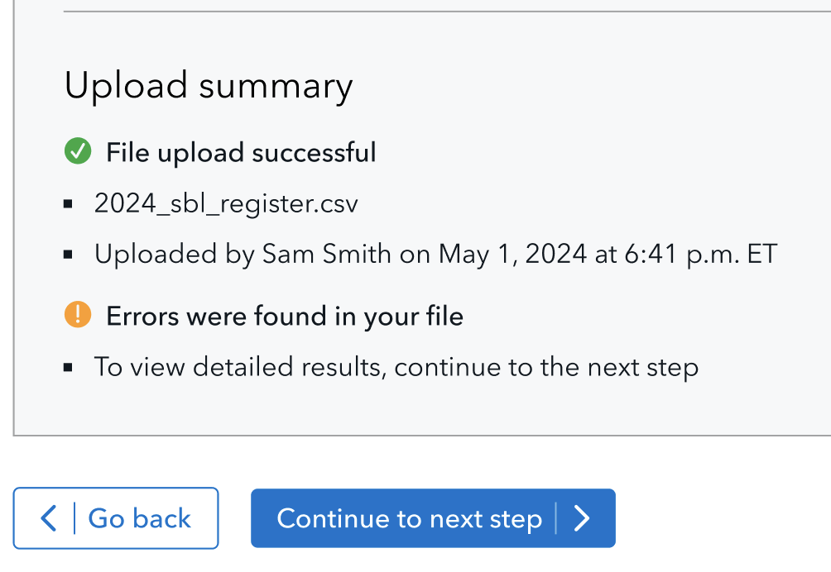
Implement an improvement – Updated design
Current design
Updated design
Notes:
We anticipate the updated design will help users more easily get to the error details page. We think this will help for this page. But there are some deeper issues around wayfinding, navigation, and expectations that won’t be fully addressed with this approach.

Slide 13
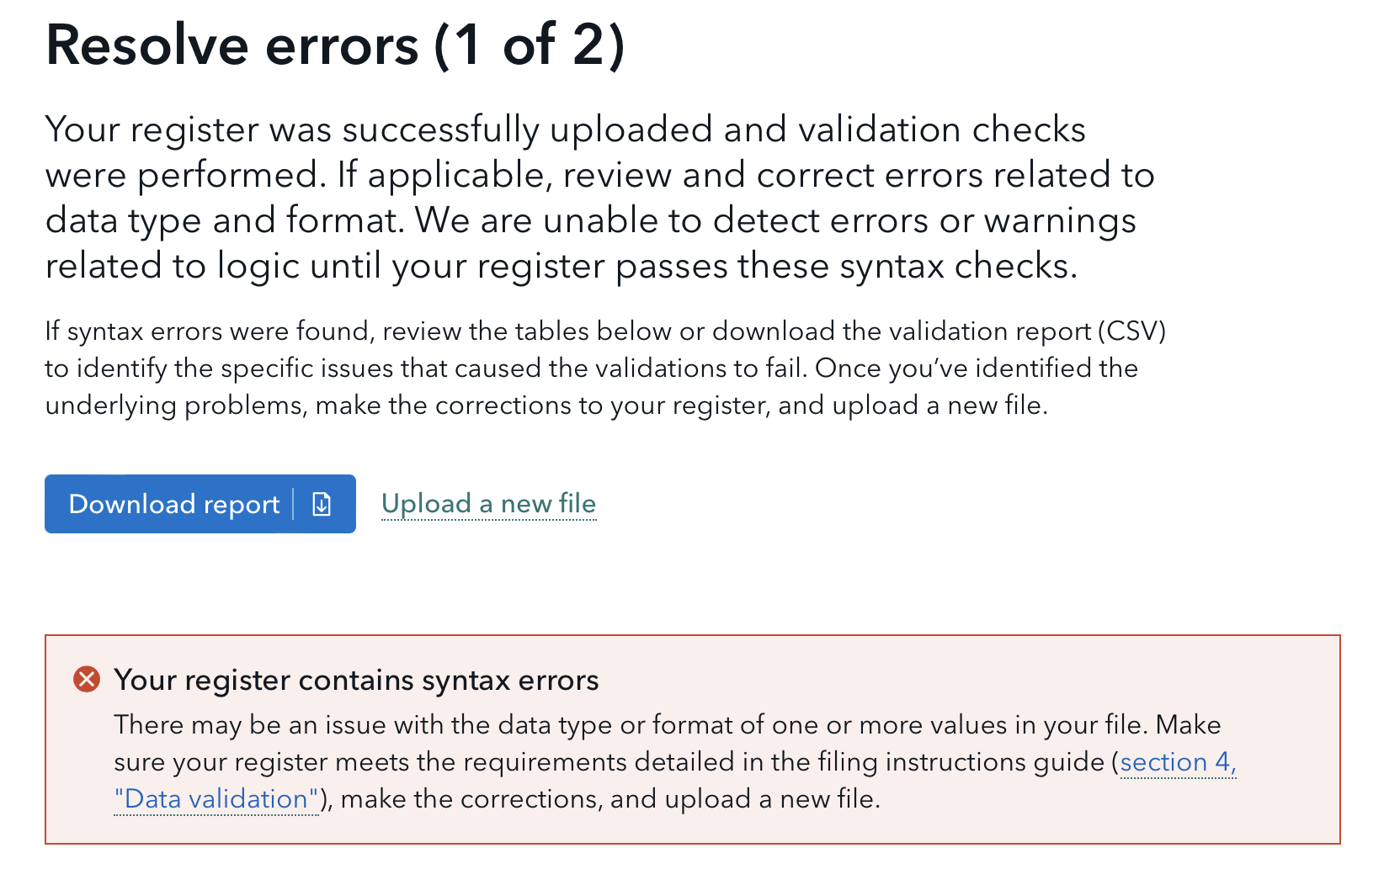
Implement an improvement
Errors
Participants were very confused by the two different error pages.
They were not sure what “1 of 2” meant.
Navigating through the errors pages when there were no errors also caused some frustration.
Notes:
- With "1 of 2" we were trying to set the expectation that they may have more than one round of fixing errors. But this approach ended up confusing and frustrating users instead.

Slide 14
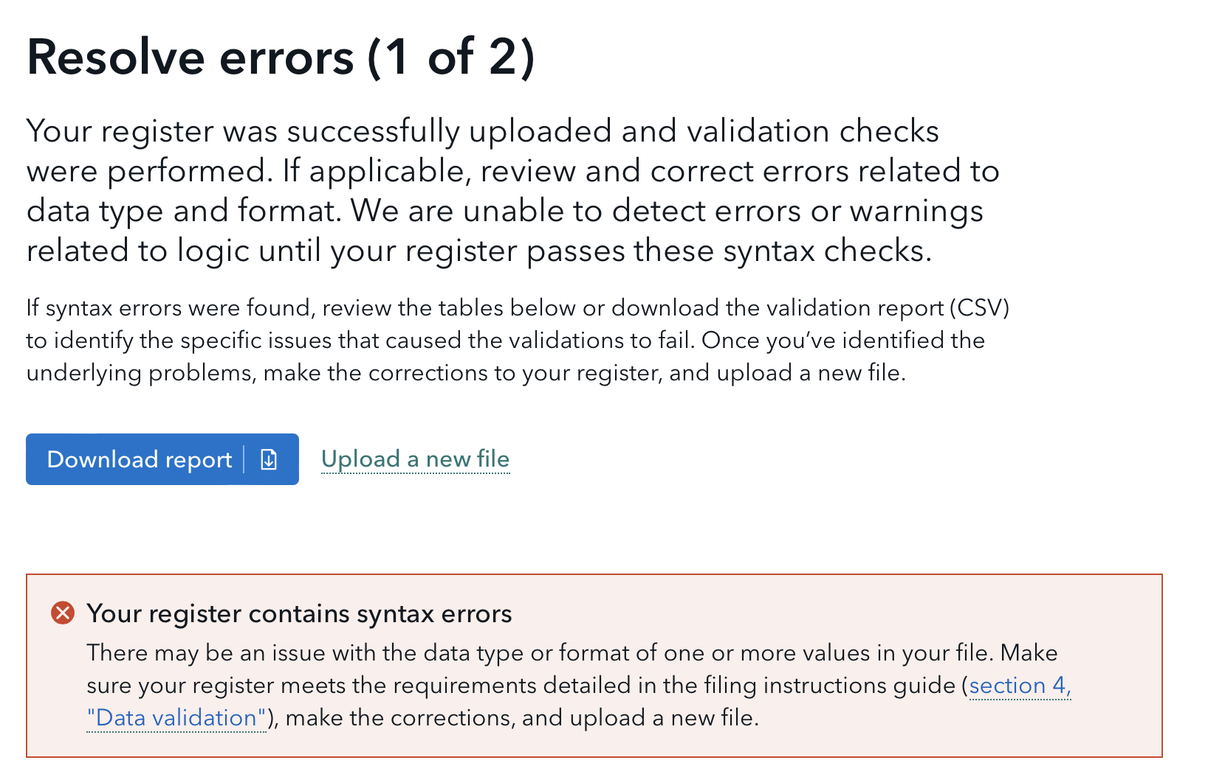
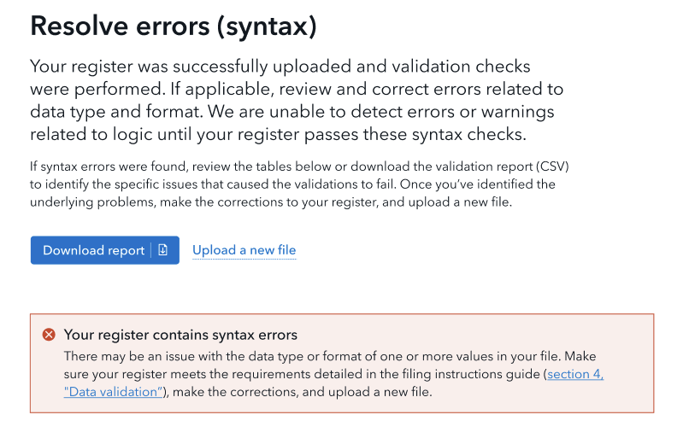
Implement an improvement – Updated design
Current design
Updated design
Notes:
We anticipate the updated design will help users more easily get through the error details page. We expect there will still be some confusion with the two errors pages because it is different from every other step.
Part of the further exploration is changing the logic for when users see these pages, how the backend identifies different types of errors, and whether it’s possible to display both types of errors on a single page.

Slide 15
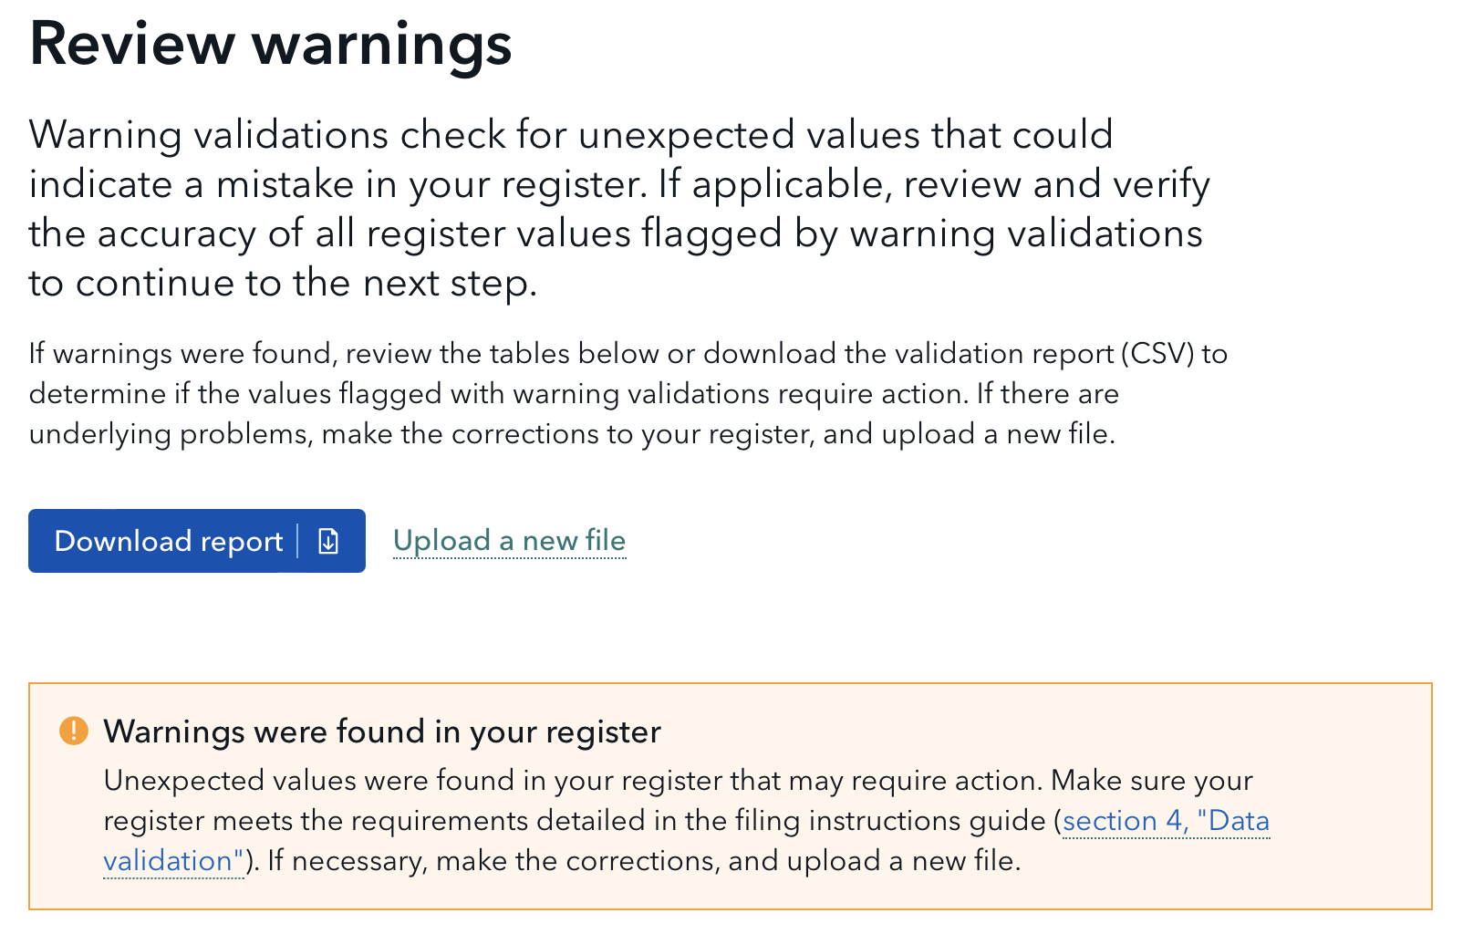
Investigate further
Warnings
Participants often conflated errors and warnings.
We need to investigate the conflation issue further.
But we think it’s tied to what users expect the filing process to be like when they are trying to submit their filing.
Notes:
- Both screenshots are displayed to show the differences, and similarities, in the design.
- The testing protocol is key here--that's how we identified the conflation
- Not having a clean distinction between these two concepts impacted what they believed they had to do next (correct errors vs verify, and maybe correct data related to, warnings).

Slide 16
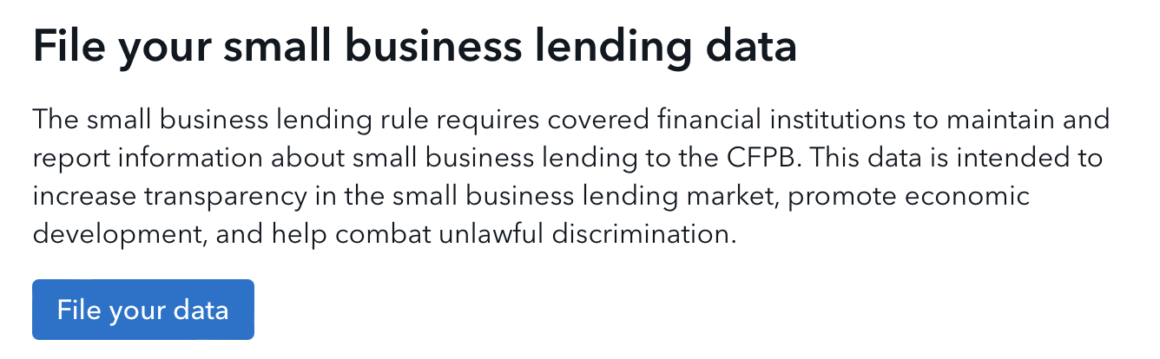
Investigate further
Filing flow expectations
Participants expected “clean” results when they went to submit their filing.
They felt uneasy when their file had errors because they thought it was possible to submit an inaccurate register.
Notes:
Our filing flow gets kicked off with this button, which was an improvement from our last round of testing.
These two bullets paint a picture of a filer’s mental model and highlight some problems we need to solve (and potential solutions to investigate):
Better communicating what a validation result means and what to do about it (i.e. better distinguishing errors and warnings)
Building trust that files they upload are not submitted until they complete the filing process (i.e. just because a file is uploaded doesn’t mean it is automatically submitted)
Finding a way to ensure that someone can’t accidentally submit the wrong file (even if it passes validation checks and has warnings verified)
A sandbox is one potential solution to this. Who has access to the sandbox and who can officially submit are details we need to explore, in addition to other elements of implementing this idea—if it’s going to solve the problem.

Slide 17
Vendor testing results
We also tested our system with two vendors.
Vendors tested their own files (with mock data)—and the platform returned the expected validation results
They appreciated the ability to download and view validation reports
The validation reports provided sufficient information to fix any issues with their files.
Notes:
“Validated as expected” means that the FIG is useful and effective, because we asked them to create files with errors and warnings. We wanted to ensure that the files they are create return the expected validation results.

Slide 18
Questions?
Notes:
To see the full results we’ll have a summary coming out that we can email.
We’re actively working to incorporate all of this feedback, and we intend to conduct more testing and collect feedback during open beta.

Slide 19
Appendix – Detailed results
Notes:
The following slides contain all of the detailed findings from our testing

Slide 20
Detailed results overview
Detailed results will be presented by task with the following structure:
Test task overview and research questions
Test task findings
Recommendations based on findings

Slide 21
Logging in: overview and findings
We used this round of testing to observe participants logging in to the system for the first time. This let us assess:
Whether there were any issues using Login.gov
Whether users had trouble completing their user profile and associating with their financial institution.
How easily participants could navigate to the platform landing page

Slide 22
Logging in: findings
100% completion rate
No problems logging in
“Below the fold” issue for completing your user profile. Participants initially didn’t see the section for selecting their financial institution. This caused a momentary pause while they figured out how to proceed.

Slide 23
Logging in: recommendations
Investigate options for ensuring that it’s clear that there is more content “below the fold” when applicable. This applies to completing your user profile as well as longer forms (e.g. for updating your financial institution profile).

Slide 24
Task 1: overview and research questions
Task 1 asked participants to update their financial institution profile by changing their parent entity to “Parent Bank 1”. This helped us assess:
What difficulty participants had reaching the “Update your financial institution profile” page
What difficulty participants had making updates to the “Update your financial institution profile” form
What additional information participants expect to see on their financial institution’s profile (e.g. who else was associated with their institution)
Whether the confirmation message set appropriate expectations for a response time.

Slide 25
Task 1: findings
100% completion rate.
No difficulty finding their financial institution profile and making updates (once they understood which field to edit).
Parent entity terminology was confusing to participants not familiar with the term. And there was a little confusion over which fields were required.
Participants did not expect to see any further information on the financial institution profile form.
The timeframe given on the confirmation message set appropriate expectations about response time, though most wanted some type of automated confirmation email.

Slide 26
Task 1: recommendations
Keep current language in the confirmation message after submitting a request to update profile information.
Send an automated confirmation email in addition to showing the confirmation message in the system.
Collaborate with SBL Support to identify which financial institution profile terms are unclear and find ways way add further information about these terms.

Slide 27
Task 2: overview and research questions
Task 2 asked participants to upload a file, assess whether there were any issues with the file, and find a way to share these results (ideally by downloading the validation report). This helped us assess:
What filers expected to see in the upload summary
Whether participants understood that the “Save and continue” button would take them to a page to view the errors in their file.
What content participants expected to see on the “Resolve errors” page
Whether participants understood that they would need to upload a new file after correcting any errors.
What participants expected their workflow to be for correcting errors.

Slide 28
Task 2: findings
100% completion rate.
Participants looked for a way to view errors in the upload summary and did not expect “Save and continue” would lead them to error details. The “Save and continue” language also caused hesitation because participants did not want to “save” a file with errors in it.
Participants partially understood they needed to upload a new file after correcting errors. Some were confused about whether the system would store multiple files. Others thought they should be able to correct errors within the UI.
Participants noted the timeline for correcting a file could be minutes to several days, depending on the number of errors and organizational structure.

Slide 29
Task 2: findings (continued)
The content on “Resolve errors” was helpful for participants.
Participants noted that multiple people from their financial institution might use the system to check files. This raised some concerns about whether a user could “accidentally” submit a file.

Slide 30
Task 2: recommendations
On the file upload page, add text in the upload summary that guides the user to the next page to view error details. Rename this section to “Upload summary”.
Change “Save and continue” button text to “Continue to next step”.
Investigate how we might support multiple users from the same institution using the system at the same time. This includes finding a way to instill trust that users can upload and check files without the risk of submitting a file they do not intend to.

Slide 31
Task 3: overview and research questions
Task 3 had participants work through the filing flow and complete the point of contact form. This helped us assess:
Where participants expected to provide point of contact information in the filing flow
Whether it’s clear that the POC is for a specific filing and not a general contact for the institution

Slide 32
Task 3: findings
50% completion rate.
This task involved repeating some of the steps from the previous task, and participants seemed to learn the general design of our system even when some aspects of the filing flow caused friction.
The use of “(1 of 2)” and “(2 of 2)” to distinguish the syntax and logic errors pages frustrated and confused participants.
Participants often thought warnings were another type of warning and had difficulty determining what they had to do with warnings.
There was no evidence that participants thought point of contact information should be collected at a different point in the process.

Slide 33
Task 3: findings (continued)
Participants seemed to understand that the point of contact (POC) form was not asking for a general POC for the institution.
Participants tended to submit their own business contact information for the point of contact (POC) form. We received mixed results about whether the participant would be the POC for the filing, so it wasn’t clear whether participants understood the intent of the point of contact form.

Slide 34
Task 3: recommendations
Investigate ways to better communicate the linear flow to the process given filer’s expectations for what they should see at each step in the process.
On the “Resolve errors” pages, replace “(1 of 2)” and “2 of 2)” with “(syntax)” and “(logic)”, respectively.
Investigate ways to better distinguish errors from warnings so that filers better know what actions they can or need to take.
For phone number fields, either automatically format the phone number as the participant types, or all for multiple format types.

